Slide 1
EASE Virtual Front Office
February 2016

Slide 2
EASE Virtual Front Office (VFO)
What is EASE?
Electronic Administration & Service Order Exchange (EASE VFO) is used for order initiation, submission, and tracking. It is a Web-based application that is used to enhance the overall process of ordering Wholesale services from CenturyLink.
EASE is the order entry application that is used by CenturyLink Wholesale customers to initiate, submit and track Access Service Requests (ASRs) for Switched Access, Special Access, CLEC Interconnection, and Wireless Interconnection services.
Notes:
Speaker Notes:
As transport revenue continue to decline, customer must sell and install 2 to 3 times as many ports to make the same margin they were making just 2-3 years ago. Selling value add services such as CenturyLink Rental CPE, Priority Access (QoS on a Dedicated Internet port), and Integrated Management along with CenturyLink IP transport services will increase margin and may significantly reduce churn.

Slide 3
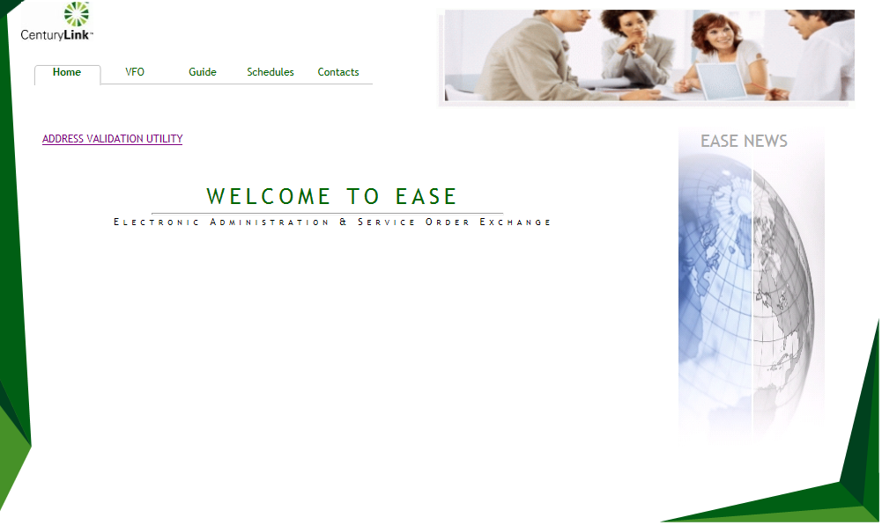
EASE Virtual Front Office Home
The Home page of EASE provides access to VFO, Guides, Schedules, and Contacts. It also provides a link to the Address Validation Utility Tool.
Notes:
Speaker Notes:
As transport revenue continue to decline, customer must sell and install 2 to 3 times as many ports to make the same margin they were making just 2-3 years ago. Selling value add services such as CenturyLink Rental CPE, Priority Access (QoS on a Dedicated Internet port), and Integrated Management along with CenturyLink IP transport services will increase margin and may significantly reduce churn.

Slide 4
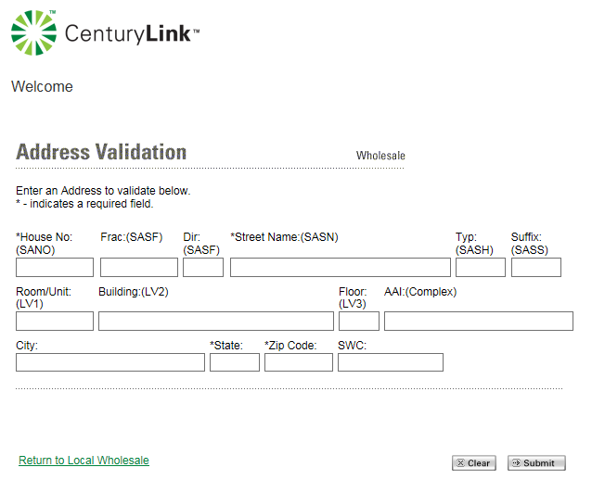
EASE Virtual Front Office Address Validation Utility
Selecting the Address
Validation Utility link on the
Home page redirects the
user to the Wholesale
Address Validation Tool.
This is a useful tool to use
prior to submitting an ASR
to CenturyLink to validate
an address.
Notes:
Speaker Notes:
As transport revenue continue to decline, customer must sell and install 2 to 3 times as many ports to make the same margin they were making just 2-3 years ago. Selling value add services such as CenturyLink Rental CPE, Priority Access (QoS on a Dedicated Internet port), and Integrated Management along with CenturyLink IP transport services will increase margin and may significantly reduce churn.

Slide 5
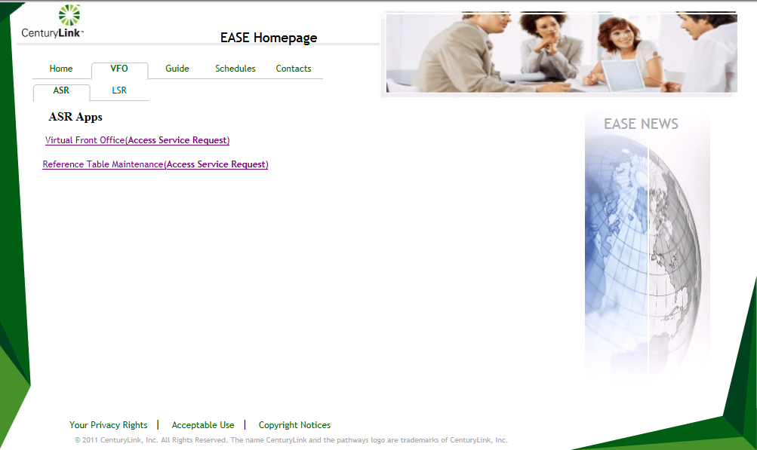
EASE Virtual Front Office VFO ASR
VFO ASR Tab provides access to the Virtual Front Office to submit ASRs as well as providing access to the Reference Table Maintenance Tool
Notes:
Speaker Notes:
As transport revenue continue to decline, customer must sell and install 2 to 3 times as many ports to make the same margin they were making just 2-3 years ago. Selling value add services such as CenturyLink Rental CPE, Priority Access (QoS on a Dedicated Internet port), and Integrated Management along with CenturyLink IP transport services will increase margin and may significantly reduce churn.

Slide 6
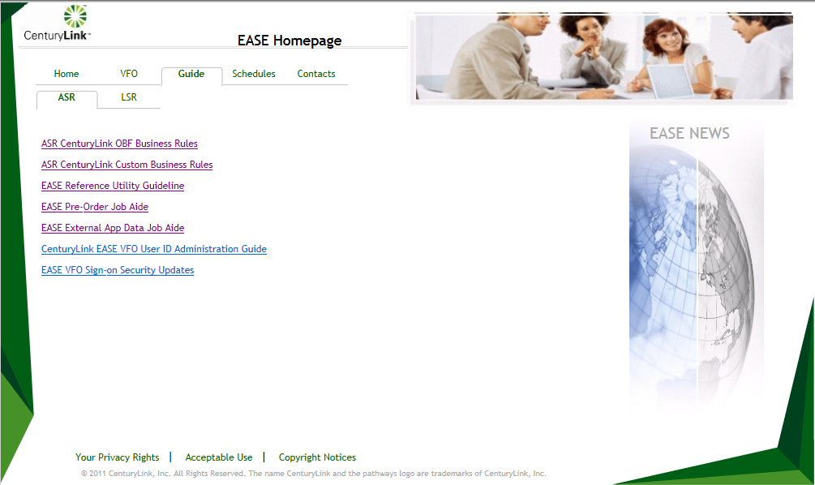
EASE Virtual Front Office Guide
The Guide Tab presents links to Business Rules, Job Aides, and other documentation.
Notes:
Speaker Notes:
As transport revenue continue to decline, customer must sell and install 2 to 3 times as many ports to make the same margin they were making just 2-3 years ago. Selling value add services such as CenturyLink Rental CPE, Priority Access (QoS on a Dedicated Internet port), and Integrated Management along with CenturyLink IP transport services will increase margin and may significantly reduce churn.

Slide 7
EASE Virtual Front Office Guide Continued
ASR CenturyLink OBF Business Rules
A listing of the most recent OBF ASOG Release business rules
ASR CenturyLink Custom Business Rules
A listing of CenturyLink specific ASOG Release business rules
EASE Reference Utility Guideline
Documents how to perform a CLLI Inquiry and a Network Channel / Network Channel Interface (NC/NCI) Inquiry
EASE Pre-Order Job Aide
Guides the user through creating a pre-order based on CFA Inquiry, CLLI Inquiry, Location Inquiry as well as Complex Address Inquiries
Notes:
Speaker Notes:
As transport revenue continue to decline, customer must sell and install 2 to 3 times as many ports to make the same margin they were making just 2-3 years ago. Selling value add services such as CenturyLink Rental CPE, Priority Access (QoS on a Dedicated Internet port), and Integrated Management along with CenturyLink IP transport services will increase margin and may significantly reduce churn.

Slide 8
EASE Virtual Front Office Guide Continued
EASE External App Data Job Aide
Guides the user through an NC/NCI Inquiry
CenturyLink EASE VFO User ID Administration Guide
Guides the user on Login tasks, New User Setup, Password Resets, User Name Deletions, and Logout tasks
EASE VFO Sign-on Security Updates
Contains General Notification Communications from CenturyLink to EASE Users
Notes:
Speaker Notes:
As transport revenue continue to decline, customer must sell and install 2 to 3 times as many ports to make the same margin they were making just 2-3 years ago. Selling value add services such as CenturyLink Rental CPE, Priority Access (QoS on a Dedicated Internet port), and Integrated Management along with CenturyLink IP transport services will increase margin and may significantly reduce churn.

Slide 9
EASE Virtual Front Office Schedules
Release schedules are posted under the Schedules tab.
Notes:
Speaker Notes:
As transport revenue continue to decline, customer must sell and install 2 to 3 times as many ports to make the same margin they were making just 2-3 years ago. Selling value add services such as CenturyLink Rental CPE, Priority Access (QoS on a Dedicated Internet port), and Integrated Management along with CenturyLink IP transport services will increase margin and may significantly reduce churn.

Slide 10
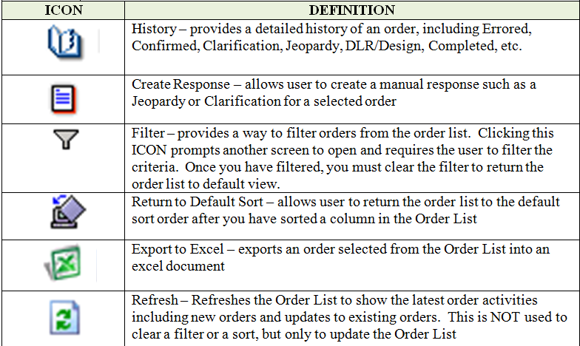
EASE Virtual Front Office VFO ASR ICONS
The user will see the following ICONS in the upper right on the Home Page of EASE.
Notes:
Speaker Notes:
As transport revenue continue to decline, customer must sell and install 2 to 3 times as many ports to make the same margin they were making just 2-3 years ago. Selling value add services such as CenturyLink Rental CPE, Priority Access (QoS on a Dedicated Internet port), and Integrated Management along with CenturyLink IP transport services will increase margin and may significantly reduce churn.

Slide 11
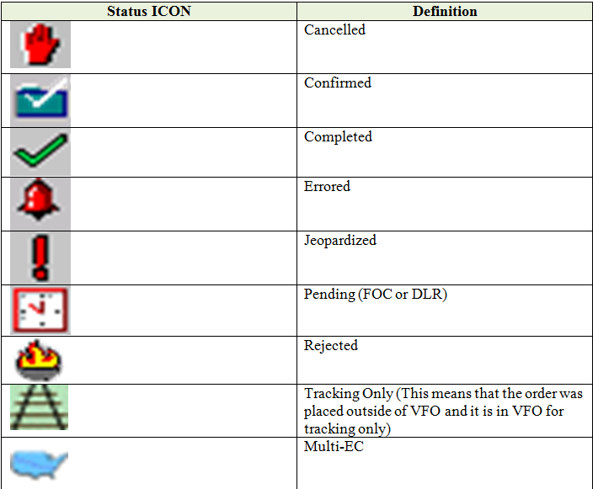
EASE Virtual Front Office VFO ASR ICONS
Status ICONS may
display to the left of the
Receiver Code column
on the Order List.
These will assist with
identifying the current
status of orders.
Notes:
Speaker Notes:
As transport revenue continue to decline, customer must sell and install 2 to 3 times as many ports to make the same margin they were making just 2-3 years ago. Selling value add services such as CenturyLink Rental CPE, Priority Access (QoS on a Dedicated Internet port), and Integrated Management along with CenturyLink IP transport services will increase margin and may significantly reduce churn.

Slide 12
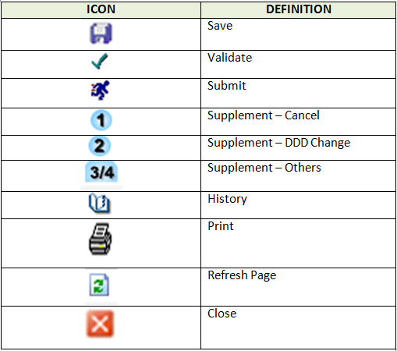
EASE Virtual Front Office VFO ASR ICONS
ICONS across the top of the
Menu bar of the order will
provide assistance in saving,
validating, submitting, etc. an
Order.
Notes:
Speaker Notes:
As transport revenue continue to decline, customer must sell and install 2 to 3 times as many ports to make the same margin they were making just 2-3 years ago. Selling value add services such as CenturyLink Rental CPE, Priority Access (QoS on a Dedicated Internet port), and Integrated Management along with CenturyLink IP transport services will increase margin and may significantly reduce churn.

Slide 13
For additional EASE support: EASE APT Help Desk: 913.353.7439 ASR Inquiries: helpdesk.ease@CenturyLink.com

